Slide 1
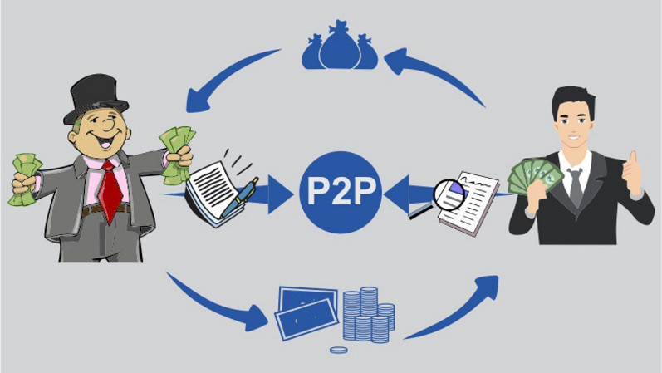
Second Case:Peer to Peer lending

Slide 2
Description of Peer to Peer lending:
Thanks to the facility of Peer to Peer lending, lending or borrowing money will not be a daunting task anymore,
P2P Lending is also called with names such as crowdfunding, marketplace lending, alternative lending and social lending.
Peer to Peer lending is a method of debt financing through which borrow money without any intermediary by another word individuals can lend.

Slide 3
Peer to Peer lending was improved by FinTech:
There is a growing Financial Technology (Fintech) business model, such as China has become the market with the most P2P lending platforms.
However, there is a moral hazard that makes this business need to be monitored.
This threat begins with verification of the borrower’s data that is not appropriate.
Considering the current market trends, it would not be wrong to state that p2p Lending has revolutionized the entire industry. To add to this, it has opened doors for all the start-up enthusiast to vent in P2P lending apps to kickstart their business.

Slide 4
Peer to Peer lending was improved by FinTech:
Greater Returns
The rates of interest are undeniably high in banks we platform of providing loans. When it comes to P2P lending both the borrower and the investor have benefit. Also the borrower has to pay a less interest rate, in addition investors could charge more than what they are paid by bank investment.
Narrowing The Process Of Application
P2P lending portals streamline the entire process with their e application, on the contrary, bank has their policies and standards, plenty of frequent visits and paper works. just a borrower needs to do to request a loan is set up his profile and with notifying the interest rate at which he expects it. Then a borrowers could then find the list to contact with the that appear feasible.
A faster process of funding
Lending apps automate the process and provide access to fund within a week. On contrary, Banks take nearly week’s before they agree on the loan amount. Additionally a user can request an amount as low, lead more visits on the app.

Slide 5
Role AI on P2P lending:
P2P lending directly connects borrowers and lenders without the intermediary.
This brings more investment opportunities, but also has unprecedented risks of default and fraud.
There is plan to develop data mining based methods and employ a big data approach .
With the help of technologies AI and big data from a variety of sources, which will be able to find ways to leverage rich datasets including user behaviors and transaction histories to detect loan request fraud more effectively and efficiently.

Slide 6
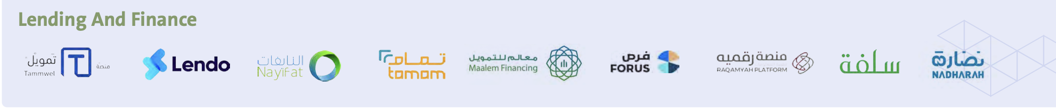
P2P lending in Saudi Arabia:
There are set of platforms to introduce peer to peer Lending in Saudi Arabia for example Forus, Raqamyah, Tmam, Nayifat and Lendo.

